Slide 1


The Movies Report
By Charlie Jin
Audience - Microsoft

Slide 2

Ultimate Goal
Find out what kind of movies to make and continue to make to earn money.
Determine what movies Microsoft should invest in to maximize profits.

Slide 3
Some factors to consider
Genres
Part of franchise or not
Expenses of the movie

Slide 4
Index
Recommendations
(Slide 5)
Recommendation #1 – Franchise Movies
(Slide 6+7)
Recommendation #2 - Genres
(Slide 8)
Recommendation #3 – High Budget Movies
(Slide 9-11)
Conclusion
[Slide 12]

Slide 5
Recommendations
Franchise movies. But based on the success/reviews of the first film.
01
More action, adventure, animation, family, blockbuster, comic book movies – the proven genres.
02
Have to spend to earn makes sense in this case. Greatest money makers are almost always costly productions.
03

Slide 6
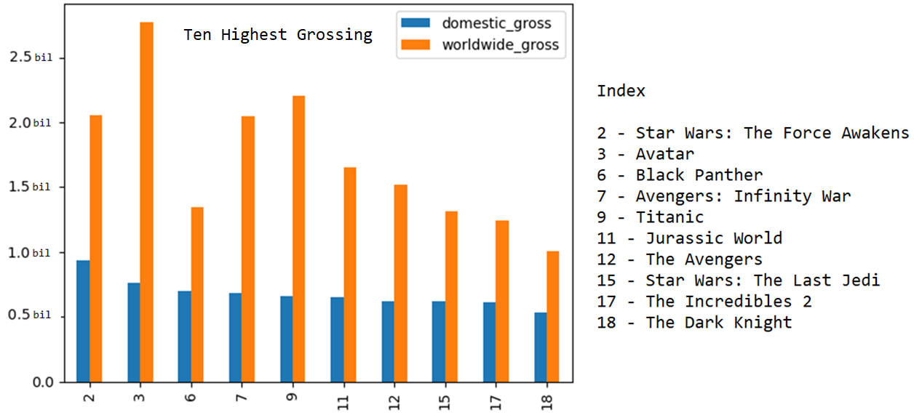
Ten Highest Grossing Movies of All Time According to Domestic Gross

Slide 7

Recommendation: Franchise Movies Why make more franchise movies?
9 out of 10 highest grossing movies (domestically) are franchise movies.
Only movie that is not a franchise movie among the Top 10 is Titanic.
7 out of 10 were not the first films of a franchise.
Audiences come back for more.
2nd film often outperforms the first.
Why? Higher expectations. Inherently effective power of franchise movies.
There is possible failure with any movie, but success rate is well worth the possibility of failure.

Slide 8

Recommendation: Genres What genres to keep making. And why?
Among Top 10 Grossing Movies
10 out of 10 are action or adventure movies.
4 out of 10 are comic book movies
These are the proven genres. The money making agents.
This is failure with action or adventure or comic book movies also, but also higher success – economically.

Slide 9
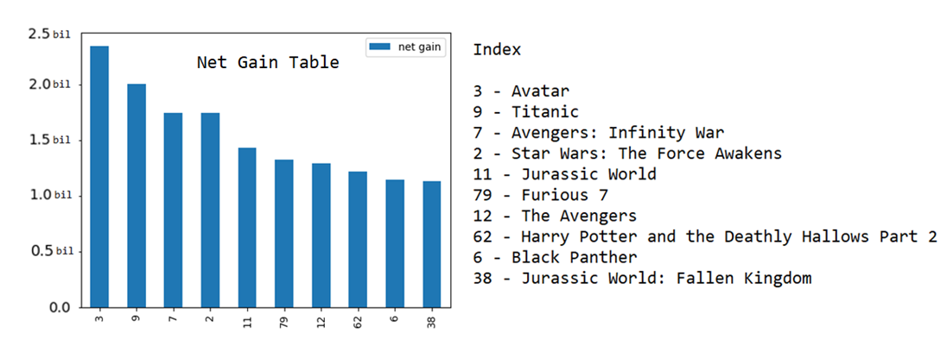
Recommendation: Expensive Movies Why make more expensive movies?

Slide 10
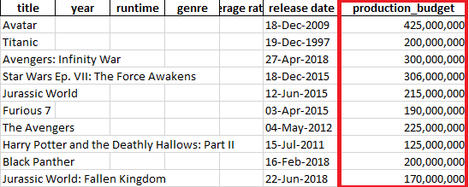
Recommendation: Expensive Movies Why make more expensive movies?
This is the production budget of the 10 most profitable (according to net gain) movies of all time.
All took at least 125 million dollars to make.
All were costly productions.

Slide 11
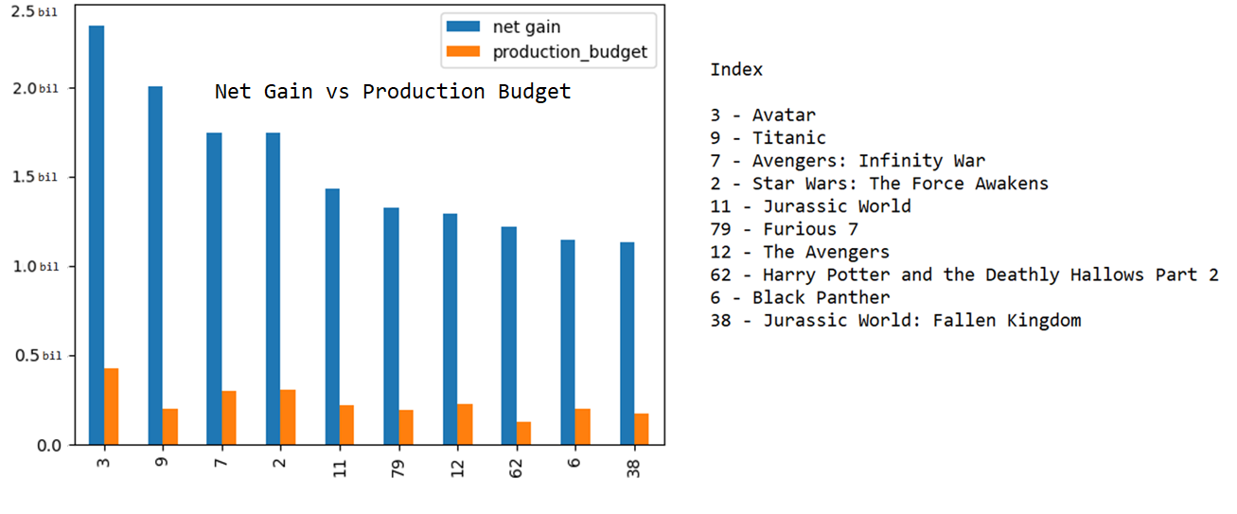
Net Gain Table Most Profitable Movies of All Time

Slide 12
Conclusion What decisions should studios make?
Action, adventure, comic book, and animation are the safest decisions to make.
Franchise movies is another proven movie maker.
Nearly all the money a studio makes are on big blockbusters expensive projects.

